Slide 1
Scales

Slide 2
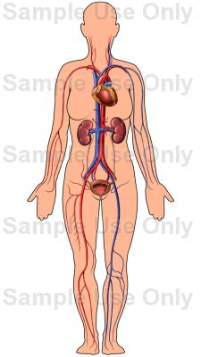
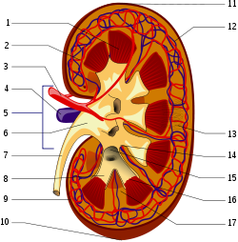
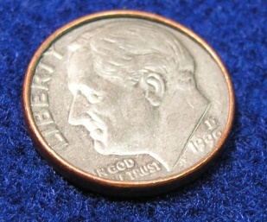
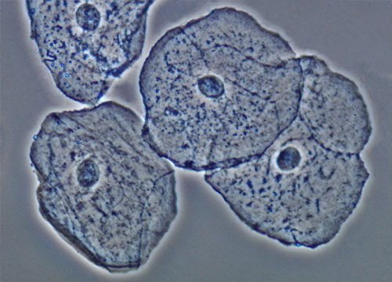
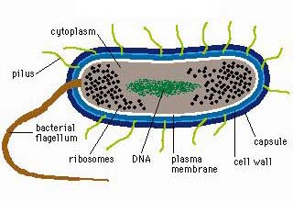

1m
1mm
1μm
1nm
1pm
Notes:
Human Body – approximately 2m
Human Kidney – approx. 50 cm or 500mm
Thickness of a dime – 1 mm
Human epithelial cell from the cheek – 100 um (μιχρομετερ)
Bacterium – 1um
Carbon atom – 200 pm
1 micro meter
1 nano meter
1 pico meter
Logorythmic scale.

Slide 3
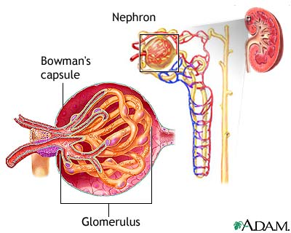
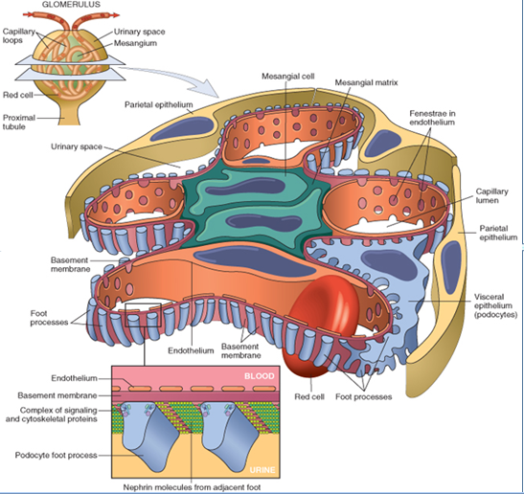
1m
1 mm
1μm
Notes:
I need to add notes to this one.

